Slide 1
Security analysis of TEA algorithm(light weight cryptography)
BY:
Poojitha Pakala(15311A12j7)
Nikhil Kumar givalla(15311A12K3)
md.Asif baba(15311A12k8)

Slide 2
Contents
What is Cryptography ?
Encryption and Decryption.
Types of Cryptography.
Elements of Cryptography.
Cryptographic Algorithms.
Light Weight Cryptography.
Areas Benefiting from Light Weight Cryptography.
Restrictions of Light Weight Cryptography.
Aim of the project

Slide 3
What is Cryptography ?
Cryptography derived its name from a Greek word called “Kryptos” which means “Hidden Secrets”.
Cryptography is the practice and study of hiding information. It is the Art or Science of converting a plain intelligible data into an unintelligible data and again retransforming that message into its original form.
It provides Confidentiality, Integrity, Accuracy.

Slide 4
Key terms of cryptography
What is a key ?
What is Plain Text ?
What is Cipher Text ?
What is Cipher ?
What is Cryptography ?
What is Cryptanalysis ?
What is Cryptology ?

Slide 5
Key terms used in cryptography
What is block cipher?
A block cipher is a method of encrypting text (to produce ciphertext) in which a cryptographic key and algorithm are applied to a block of data (for example, 64 contiguous bits) at once as a group rather than to one bit at a time. The main alternative method, used much less frequently, is called the stream cipher.
What is feistal cipher?
Feistel cipher are a special class of iterated block ciphers where the cipher text is calculated from the plain text by repeated application of the same transformation or round function.

Slide 6
Types of cryptography
There are mainly two types of Cryptography :
1)Symmetric Key Cryptography
2)Asymmetric Key Cryptography

Slide 7
Light Weight Cryptography :
Lightweight block ciphers are a rapidly growing field of symmetric cryptography that have extensive applications in diverse industries.
Lightweight Cryptography is the collection of cryptographic primitives, techniques and ciphers that can be implemented and designed to minimize memory footprint and increase the speed .
Light Weight Cryptographic Algorithms are ultra-light weight block ciphers like :
Present Encryption Algorithm.
Tiny Encryption Algorithm.
Scalable Encryption Algorithm.
Height Encryption Algorithm.

Slide 8
Cryptographic Algorithms widely used before light weight cryptography
DES (Data Encryption Standard ) :
It uses a 56-bit encryption key which can give around 2^56 (256) combinations to encrypt the plain text . DES is restricted with a block size of 64 bits .
AES(Advanced Encryption Standard) :
AES is not suitable for extremely constrained environments such as RFID tags and sensor networks.

Slide 9
DIFFE HELLMAN KEY EXCHANGE
The Diffie-Hellman Key Exchange is a cryptographic protocol that allows two parties with no prior knowledge of each other to establish a shared secret key, which typically cipher
Hellman Key Exchange relies on exponential functions computing much faster than discrete logarithms. When used properly, the Diffie-Hellman Key Exchange protocol gives two parties key without actually transmitting it. The strength of this algorithm depends on the time it takes to compute a discrete logarithm of the public keys transmitted (Diffie, Hellman 1976).

Slide 10
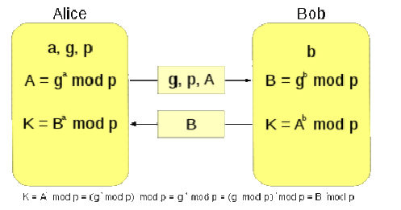
TO BE CONTINUED..

Slide 11
TEA ALGORITHM
The Tiny Encryption Algorithm (TEA) is one of the fastest and most efficient cryptographic algorithms in existence.
The Tiny Encryption Algorithm (TEA) is a symmetric (private) key encryption algorithm created by David Wheeler and Roger Needham of Cambridge University and published in 1994
TEA is a symmetric key algorithm.
TEA is designed to minimize memory footprint and maximize speed.
It is a Feistel type cipher
Achieves the Shannon's properties of complete diffusion and confusion with out the employment of S & P boxes, after only six rounds but thirty two rounds are recommended.

Slide 12
FUNCTIONALITY OF TEA
Inputs to encryption algorithm are 64 bits of plain/cipher text , 128 bits of key and output is a cipher/plain text.
It performs operations on 32 bit words.
Each round has 4 sub key k[i].
Each half of message is used to encrypt the other half over 64 rounds of processing and then combine to produce the cipher text block.
A half block is processed and swapped iteratively and all operations are performed on modulo 32‐bit

Slide 13
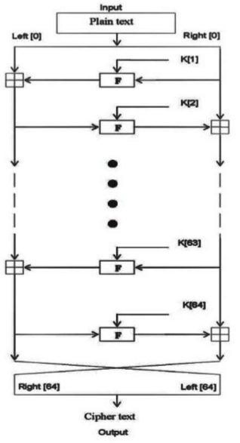
TEA ENCRYPTION ROUTINE
The inputs to the encryption algorithm are a
plaintext block and a key K.
The plaintext is P = (Left [0], Right [0]) and the
cipher text is C = (Left [64], Right[64]).
The plaintext block is split into two halves,
Left [0] and Right[0].
Each half is used to encrypt the other half
over 64rounds of processing and then combine to
produce the cipher text block.
.

Slide 14
To be continued..
Each round i has inputs Left[i-1] and Right[i-1], derived from the
previous round, as well as a sub key K[i] derived from the 128 bit overall K.
The sub keys K[i] are different from K and from each other.
The constant delta = (5- 1)*2³¹=9E3779B9_{h}, is derived from the
golden number ratio to ensure that the sub keys are distinct and
its precise value has no cryptographic significance.
The round function differs slightly from a classical Fiestel cipher
structure in that integer addition modulo 2³² is used instead of exclusive-or as the combining operator

Slide 15
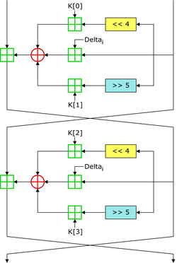
Decryption Methodology
In this case, the constant delta value
DELTA(i-1) is “C6EF3720”, where „i‟
represents the number of iterations.
In each iteration, the delta value
“9E3779B9” is subtracted with the
constant delta value.
To decrypt the encrypted data the
reverse operation of the encryption
process can be done since TEA uses
Fiestel structure.
The cipher starts with a 64 bit data block
that is split up into two 32 bit blocks
which we will call L and R. L is the left side
of the block

Slide 16
CRYPTANALYSIS
Cryptanalysis is the art of analyzing and breaking ciphers.
It is an attempt to take cipher text produced by an adversary and produce the plain text or,better yet,the key.
In intutive terms a attack on a cryptosystem is any method of starting with some information about plaint texts and their corresponding cipher texts under some (unknown) key and figuaring out more information about the plain texts.
In our project we have implemented “EQUIVALENT KEYS PARTIAL ATTACK”

Slide 17
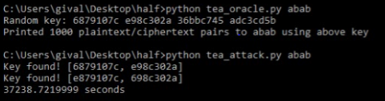
ATTACK PROCESS:

Slide 18
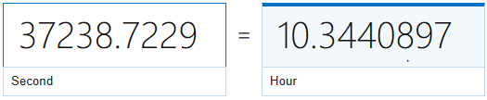
TIME TAKEN TO OBTAIN AN EQUIVALENT KEY

Slide 19
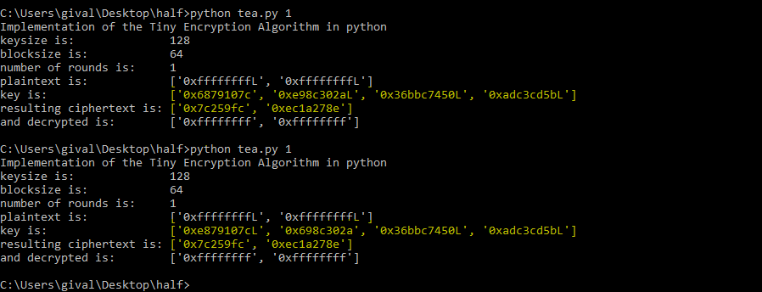
To prove that these keys are actually equivalent:

Slide 20
Importance of Security
As computer systems become more pervasive and complex, security is increasingly important. Even if a cryptographic algorithm is ideal in both theory and implementation, the strength of the algorithm will be rendered useless if the relevant keys are poorly managed
Cryptography is the art and science behind the principles, means, and methods for keeping messages secure. Cryptanalysis is a study of how to compromise (defeat) cryptographic mechanism.

Slide 22
Aim of our project
Security of the system will depend mainly on methods used to manage and establish and distribute keys and also on relevant keys management
This project aims at inspecting few of the methods in the cryptanalysis of a TEA algorithm and to observe the possibilities of breaking the cipher text by attacker .
Analysis of how many encryptions and how many known plain text and cipher text are required for attacker to succeed
Such that we can ensure to which extend it is secured and where we can use this and where we cant

Slide 23
Thank you!!

